Slide 1
Preference-based Inverse Reinforcement Learning
Bachelor Thesis Final Presentation
Andreas Binder
Munich, 23.10.2020

Slide 2

Andreas Binder
Bachelor’s degree candidate
inovex
DMA
Bachelor thesis
Education:
Information Systems
Technical University Munich

Slide 3
Agenda
Motivation and Research Questions
Reinforcement Learning
Inverse Reinforcement Learning
Simulation & System Overview
Approach & Results
Critic
Outlook & Discussion

Slide 4
Agenda
Motivation and Research Questions
Reinforcement Learning
Inverse Reinforcement Learning
Simulation & System Overview
Approach & Results
Critic
Outlook & Discussion

Slide 5

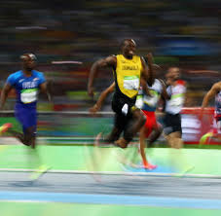
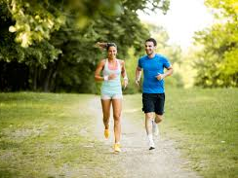
Motivation
Can I infer the intention from demonstrations?
Notes:
Imagine we had access to demonstrations of a task we want to perform and by comparing them we can find out what is the goal and how can we achieve it
Why?: easier to obtain

Slide 6
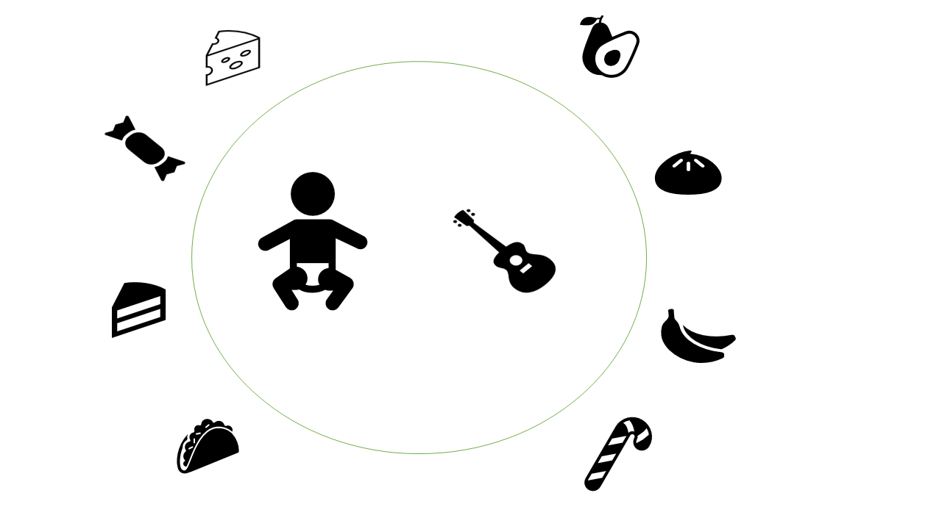
Motivation
What is the right reward signal?
Notes:
Imagine we had access to demonstrations of a task we want to perform and by comparing them we can find out what is the goal and how can we achieve it
Why?: easier to obtain

Slide 7
Research Questions
Is it possible to teach a snake-like agent how to move forward efficiently using ranked, suboptimal trajectories?
How does the kind of used ranking mechanism impact the performance?
Notes:
RQ as guide through today’s presentation

Slide 8
Agenda
Motivation and Research Questions
Reinforcement Learning
Inverse Reinforcement Learning
Simulation & System Overview
Approach & Results
Critic
Outlook & Discussion

Slide 9
Research Questions
Is it possible to teach a snake-like agent how to move forward efficiently using ranked, suboptimal trajectories?
How does the kind of used ranking mechanism impact the performance?
Notes:
gonna discuss the learning part in my project

Slide 10
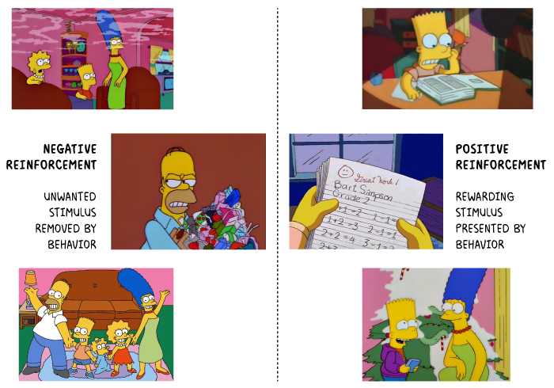
Reinforcement Learning - Intuition
https://www.psychestudy.com/behavioral/learning-memory/operant-conditioning/reinforcement-punishment/positive-negative-reinforcement
Notes:
Origin: Classical conditioning
Source: https://www.psychestudy.com/behavioral/learning-memory/operant-conditioning/reinforcement-punishment/positive-negative-reinforcement

Slide 11
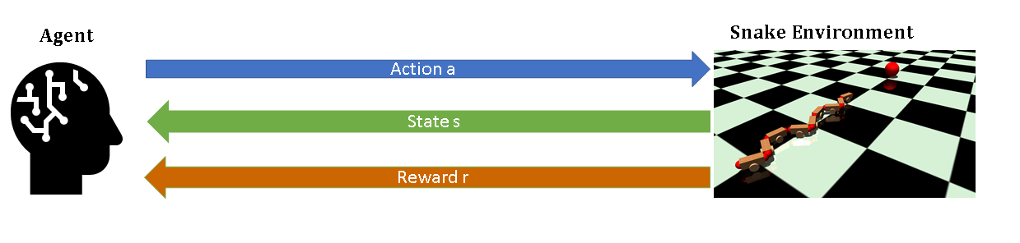
Underlying Framework: Markov Decision Process
Missing here:
Sensors (eyes - camera)
Actuators (foot - wheel)
Further assumptions:
focus on episodic tasks (tasks that have a final state or certain duration)
Notes:
Example: moving forward

Slide 12
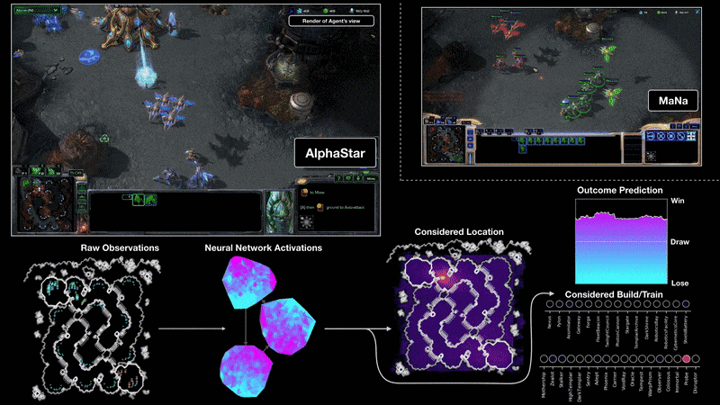
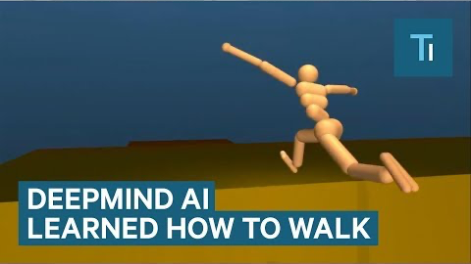
Reinforcement Learning - Success Stories
https://deepmind.com/blog/article/alphastar-mastering-real-time-strategy-game-starcraft-ii
https://www.youtube.com/watch?v=gn4nRCC9TwQ
RL in Games
RL in Robotics
Notes:
Starcraft

Slide 13
Research Questions
Is it possible to teach a snake-like agent how to move forward efficiently using ranked, suboptimal trajectories?
How does the kind of used ranking mechanism impact the performance?
Notes:
kind of optimization

Slide 14
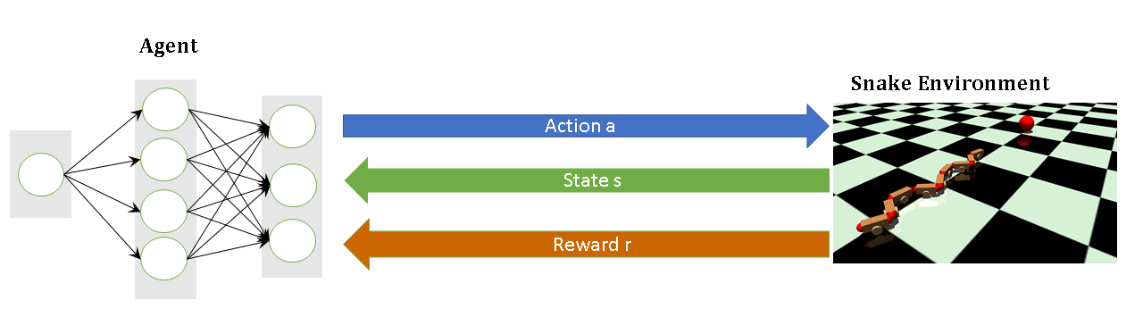
Role of Deep Learning
use neural network for
policy (decision making) or
value function (estimate value of states) or
both
Deep Reinforcement Learning
Notes:
DL + RL = Deep Reinforcement Learning
"quality" of an action taken in a given state

Slide 15
Problems of Reinforcement Learning
Sample Efficiency
How much data do I need for good results?
Reward Shaping
Which function rewards good behaviour and punishes bad behaviour?
Notes:
just an excerpt of problems
primiarly the second problem

Slide 16
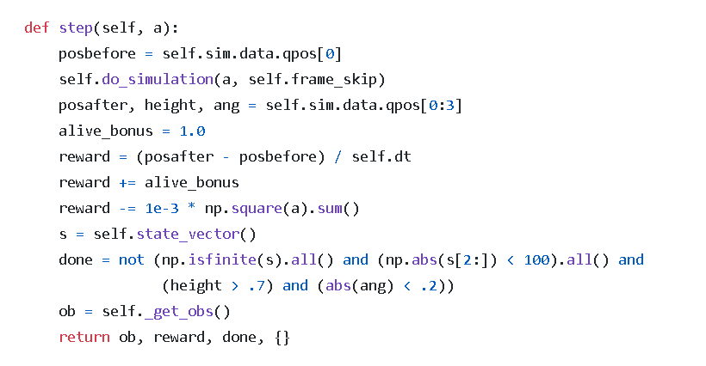
Notes:
Imagine we had access to demonstrations of a task we want to perform and by comparing them we can find out what is the goal and how can we achieve it
Why?: easier to obtain

Slide 17
define position before and after simulation
https://arxiv.org/abs/1709.06560
Notes:
Imagine we had access to demonstrations of a task we want to perform and by comparing them we can find out what is the goal and how can we achieve it
Why?: easier to obtain

Slide 18
calculate reward
https://arxiv.org/abs/1709.06560
Notes:
Imagine we had access to demonstrations of a task we want to perform and by comparing them we can find out what is the goal and how can we achieve it
Why?: easier to obtain

Slide 19
https://arxiv.org/abs/1709.06560
is episode over?
Notes:
Imagine we had access to demonstrations of a task we want to perform and by comparing them we can find out what is the goal and how can we achieve it
Why?: easier to obtain

Slide 20
https://arxiv.org/abs/1709.06560
retrieve observation and return information
Notes:
state information/ observation synonym

Slide 21
hardcoded reward might evoke unintended behaviour
https://arxiv.org/abs/1709.06560
https://arxiv.org/abs/1709.06560
Notes:
one way of phrasing the task, a lot of assumptions made

Slide 22
Agenda
Motivation and Research Questions
Reinforcement Learning
Inverse Reinforcement Learning
Simulation & System Overview
Approach & Results
Critic
Outlook & Discussion

Slide 23
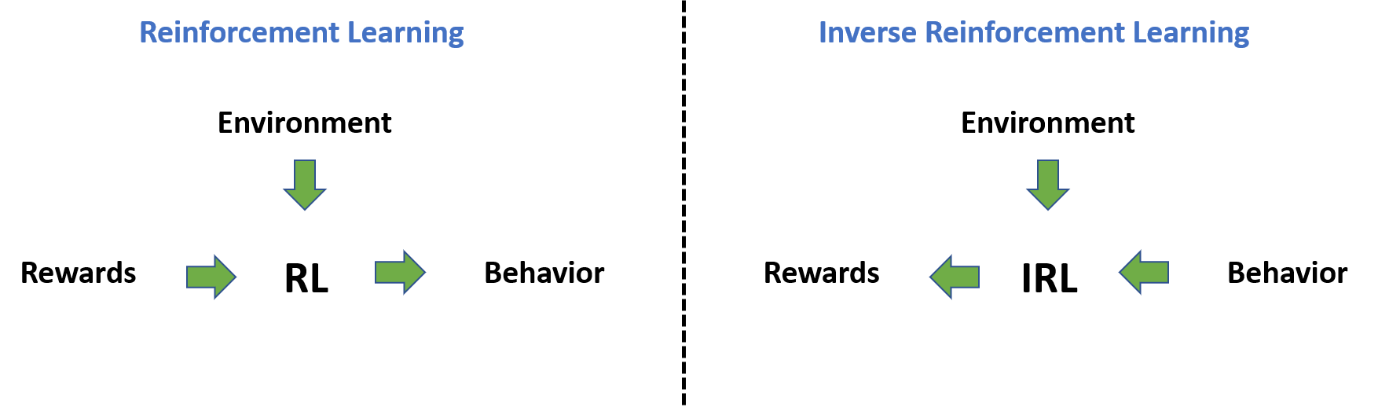
Inverse Reinforcement Learning
Infer reward function from observations (and actions)
considered part of RL
RL vs IRL:
https://towardsdatascience.com/inverse-reinforcement-learning-6453b7cdc90d
Notes:
solution

Slide 24
Research Questions
Is it possible to teach a snake-like agent how to move forward efficiently using ranked, suboptimal trajectories?
How does the kind of used ranking mechanism impact the performance?

Slide 25


Learning to Rank
Information Retrieval
Recommender Systems

Slide 26
Overview of used Techniques
Reinforcement
Learning
Deep Learning
Learning to Rank/
Learning from Preferences

Slide 27
Agenda
Motivation and Research Questions
Reinforcement Learning
Inverse Reinforcement Learning
Simulation & System Overview
Approach & Results
Critic
Outlook & Discussion
Notes:
IRL in short, because RL in detail, and concepts apply to both

Slide 28
Research Questions
Is it possible to teach a snake-like agent how to move forward efficiently using ranked, suboptimal trajectories?
How does the kind of used ranking mechanism impact the performance?

Slide 29
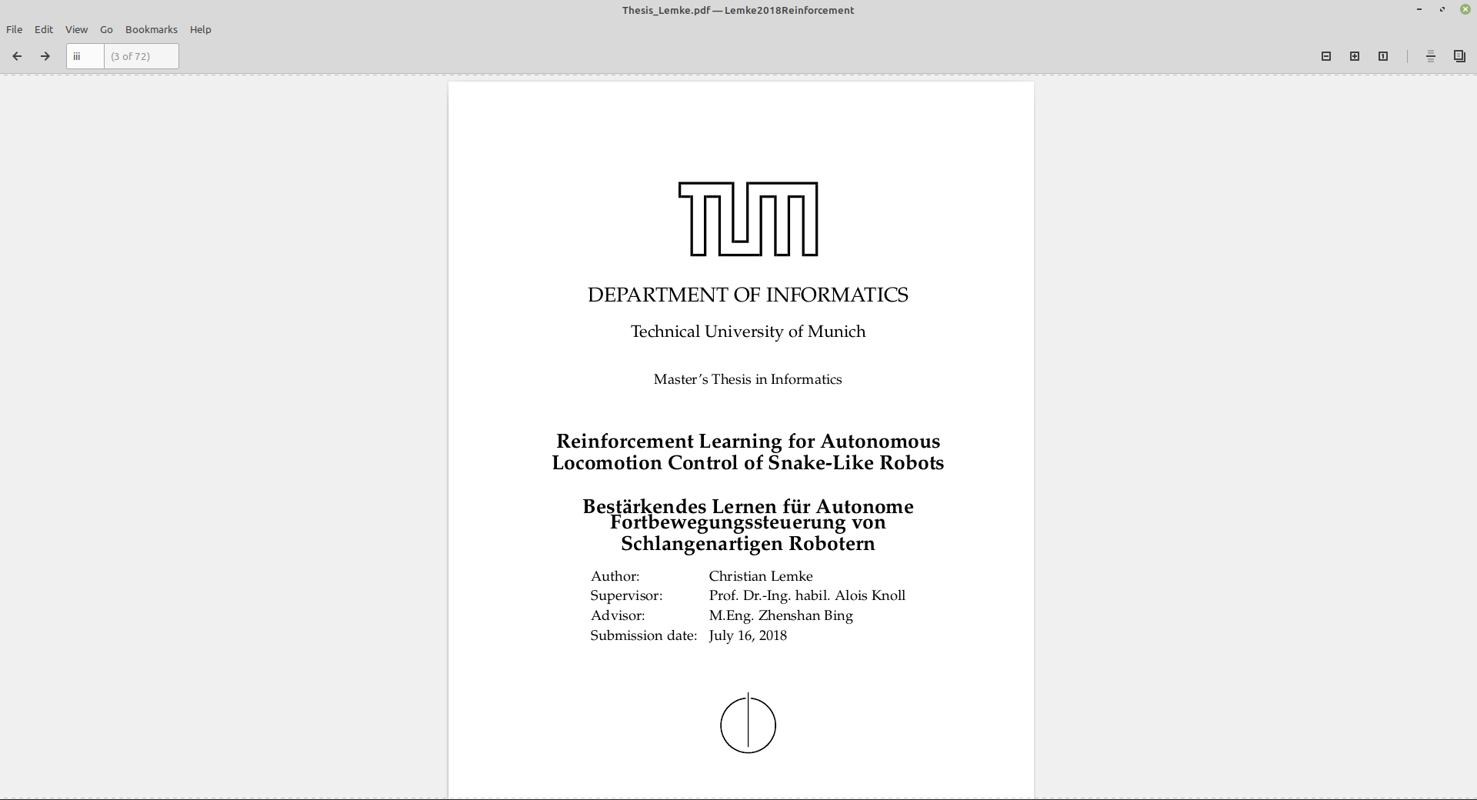
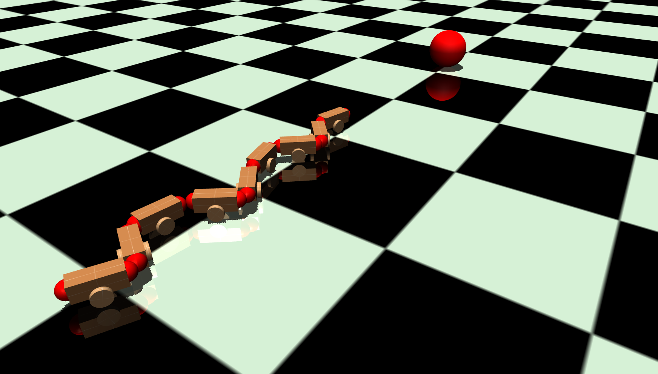
Snake-like Robot
Notes:
9 modules, 8 joints
wheels simulate

Slide 30





Components
Deep RL
RL
Notes:
9 modules, 8 joints
wheels simulate

Slide 31
System View
PrefNet System
Deep RL
RL
Gym
Snake Env
MuJoCo
Physics
Engine
Tensorflow
Agent
mujoco-py
PyTorch

Slide 32
Agenda
Motivation and Research Questions
Reinforcement Learning
Inverse Reinforcement Learning
Simulation & System Overview
Approach & Results
Critic
Outlook & Discussion

Slide 33
Steps
Data creation via RL agent
Data labeling
Preference learning
Run RL agent to validate result
Notes:
checkpoint policy every n-th timestep and use that to create trajectories

Slide 34
Steps
Data creation via RL agent
Data labeling
Preference learning
Run RL agent to validate result
Notes:
checkpoint policy every n-th timestep and use that to create trajectories

Slide 35
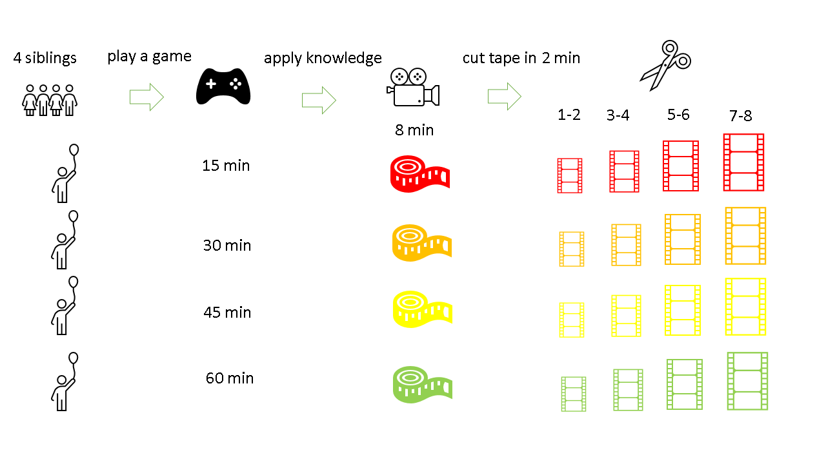
Notes:
checkpoint policy every n-th timestep and use that to create trajectories

Slide 36
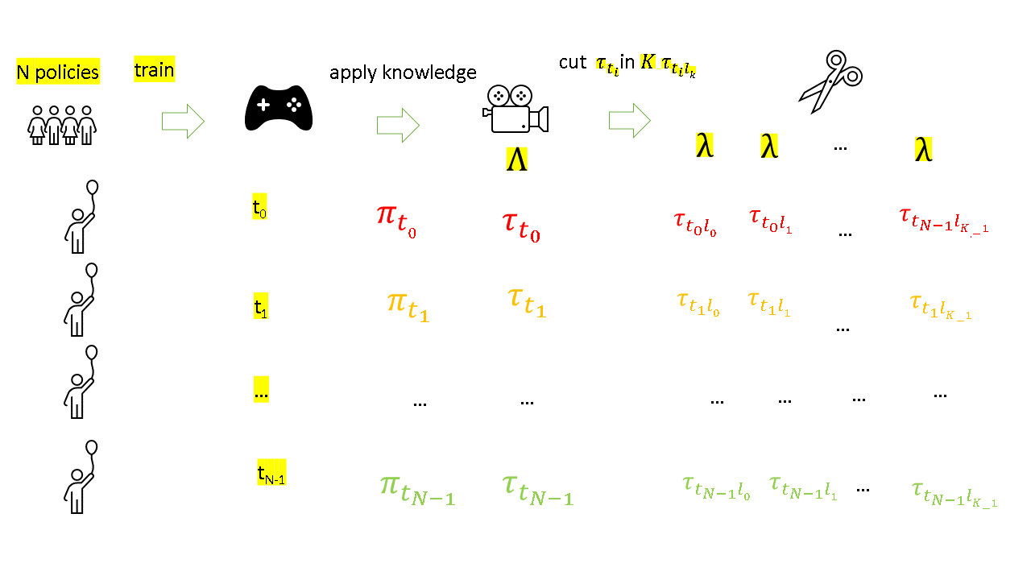
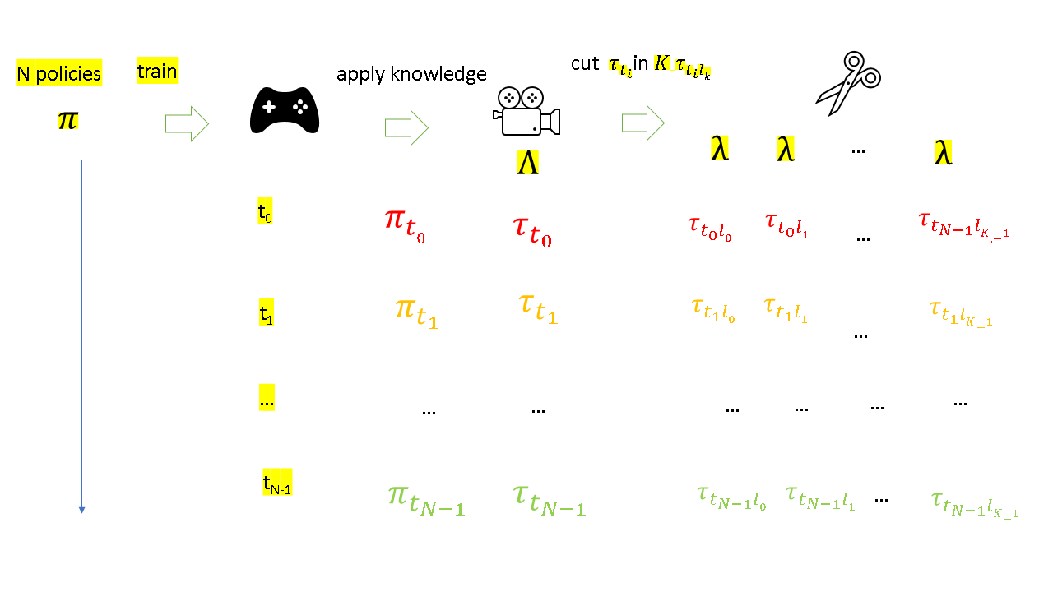
Notes:
checkpoint policy every n-th timestep and use that to create trajectories

Slide 37
Steps
Data creation via RL agent
Data labeling
Preference learning
Run RL agent to validate result
Notes:
Create Pairs, Triplet etc.

Slide 38
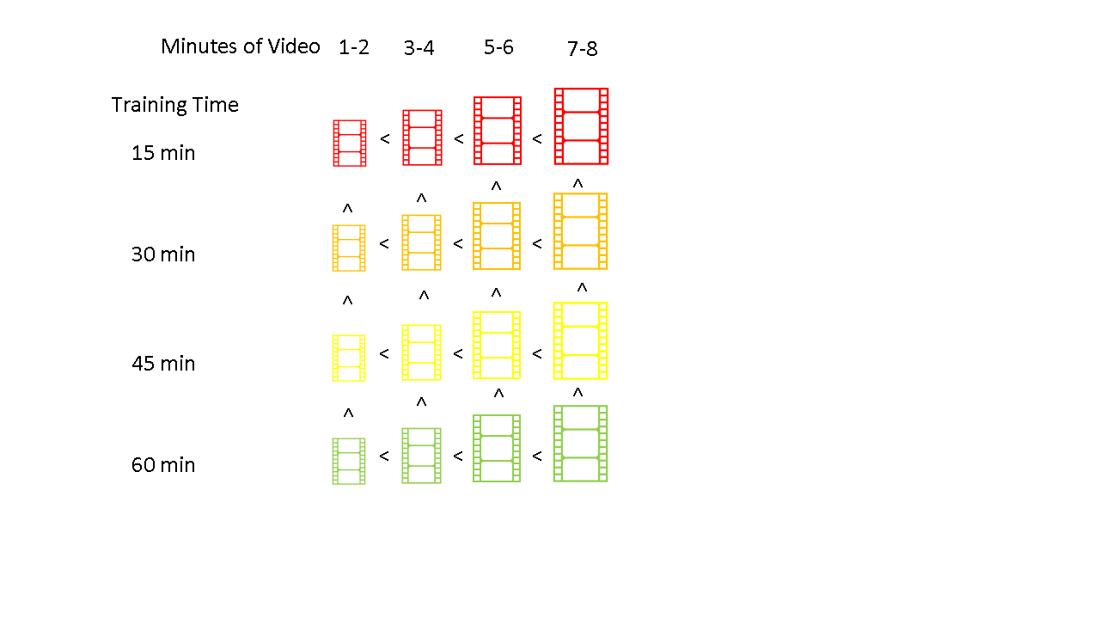

Slide 39
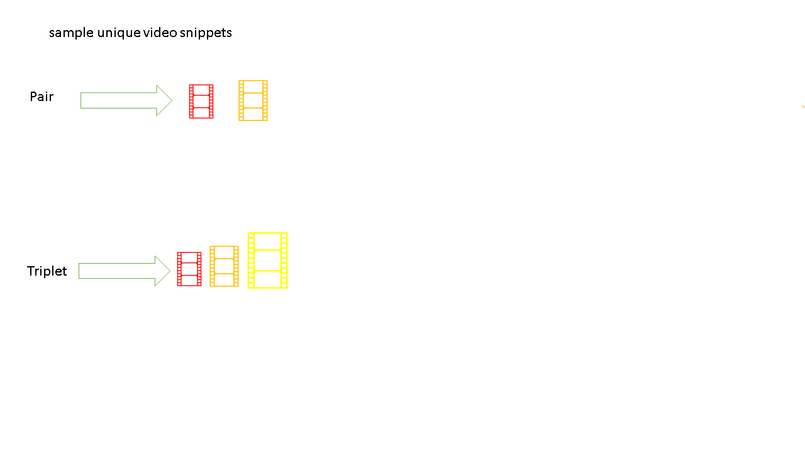

Slide 40
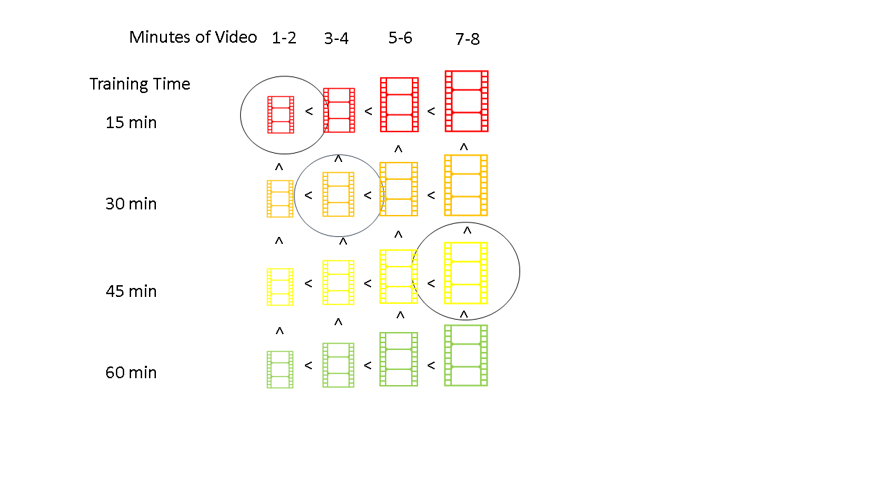

Slide 41







sample unique video snippets
label the snippets
Pair
Triplet

Slide 42
Minutes of Video
1-2
3-4
5-6
7-8
Training Time
:= baseline
<
<
<
<
<
<
<
30 min
<
<
<
:= target
<
<
<
<
45 min
<
<
<
<
<
<
<
60 min
<
<
<

Slide 43
sample video snippets
label the snippets
Pair
Triplet

Slide 44

Minutes of Video
1-2
3-4
5-6
7-8
Training Time
Intuition:
We do not want to compare the begin of a better video with the end of a worse video.
Otherwise, we cannot guarantee a monotonic increase in reward
<
<
<
<
<
<
<
30 min
<
<
<
<
<
<
<
45 min
<
<
<
<
<
<
<
Monotony Check
60 min
<
<
<
Notes:
Rule of thumbs: dotted lines are not allowed to cross

Slide 45

Minutes of Video
Example:
1-2
3-4
5-6
7-8
Training Time
<
<
<
<
<
<
<
30 min
<
<
<
<
<
<
<
45 min
<
<
<
<
<
<
<
60 min
<
<
<

Slide 46


sample unique video snippets
label the snippets
monotony check
Pair
Pair
Triplet
Triplet
NaiveTriplet

Slide 47
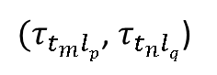
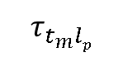
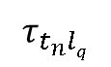
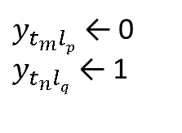
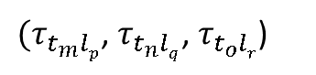
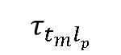
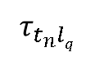
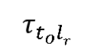
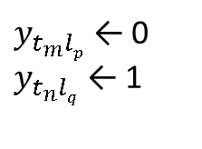
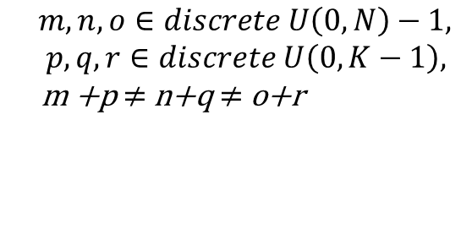
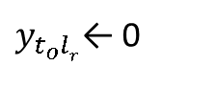
sample unique subtrajectories
label the subtrajectories
monotony check
Pair
Pair
Triplet
Triplet
NaiveTriplet

Slide 48
Result
three video clips, each of length 2 min, and preference labels
...
...

Slide 49
Steps
Data creation via RL agent
Data labeling
Preference learning
Run RL agent to validate result
Notes:
can use ensemble

Slide 50


Slide 51
(for Triplet case)
compare estimations for clips to label
watches clips
gives prediction
per min
sum predictions per clip
[[5,10],
[7,5],
[8,12]]
[[15],
[12],
[20]]
2 min
2 min
2 min

Slide 52
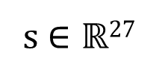
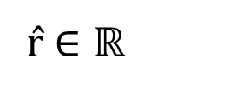
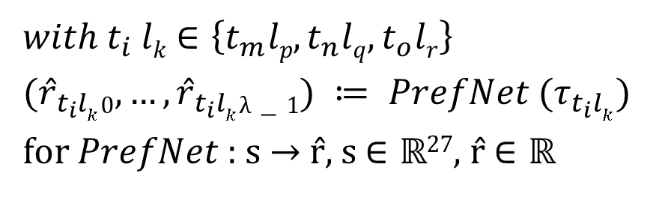
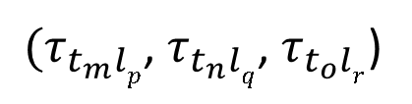
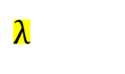
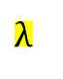
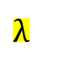
1/2
(for Triplet case)
1 neuron
27 neurons
256 neurons
256 neurons
forward pass of
subtrajectories
sum predictions per subtrajectory

Slide 53
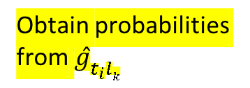
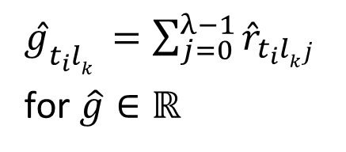
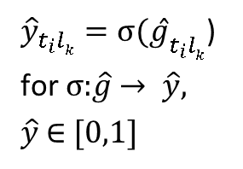
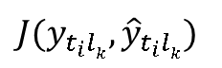
2/2
(for Triplet case)
compare estimations for subtrajectory to label
sum predictions per subtrajectory

Slide 54
Steps
Data creation via RL agent
Data labeling
Preference learning
Run RL agent to validate result
Notes:
can use ensemble

Slide 55


Slide 56

Action a
State s
Prediction r̂
Reward r

Slide 57
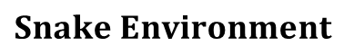

Action a
State s
Prediction r̂
Reward r

Slide 58
Experiments
Is it possible to teach a snake-like agent how to move forward efficiently using ranked, suboptimal trajectories?
Exp. 1: RL evaluation on learnt reward function
How does the kind of used ranking mechanism impact the performance?
Exp. 1: RL evaluation on learnt reward function
Exp. 2: Ranking Quality
Exp. 3: Ground-truth Correlation
Notes:
RQ as guide through today’s presentation

Slide 59
RL Evaluation
for agent in agents:
Action a
State s
Prediction r̂
Reward r

Slide 60
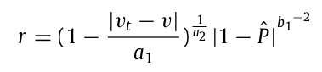
Ground-truth Reward
Forward Locomotion
Energy Consumption

Slide 61
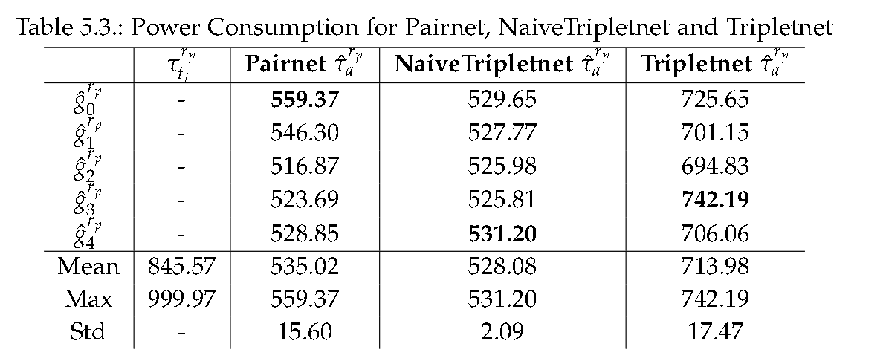
Power Consumption

Slide 62
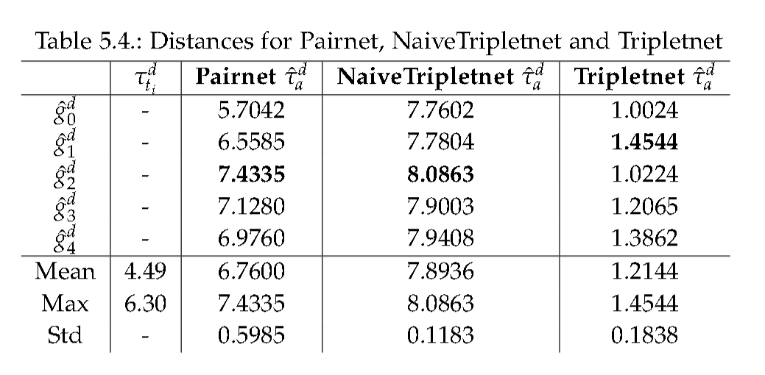
Distance Traveled

Slide 63
Research Questions
Is it possible to teach a snake-like agent how to move forward efficiently using ranked, suboptimal trajectories?
all presented approaches move forward with moderate power consumption
How does the kind of used ranking mechanism impact the performance?
NaiveTriplet and Pair cover more distance than Triplet
Notes:
RQ as guide through today’s presentation

Slide 64
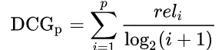
Ranking Quality
measured by Normalized Discounted Cumulative Gain (NDCG)
compute DCG score of optimal ranking and predicted ranking and divide the predicted by the optimal

Slide 65
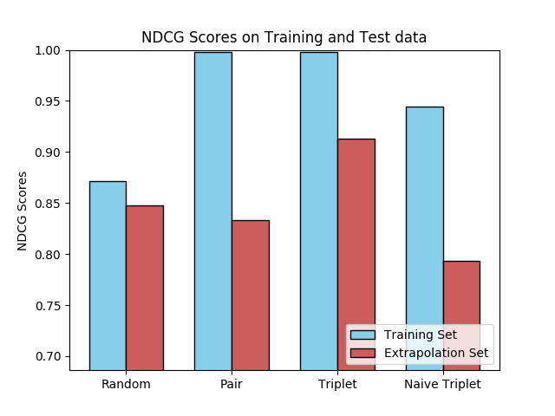
Ranking Quality

Slide 66
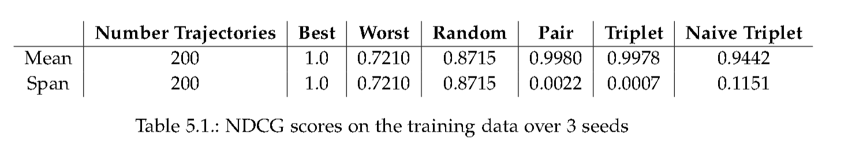
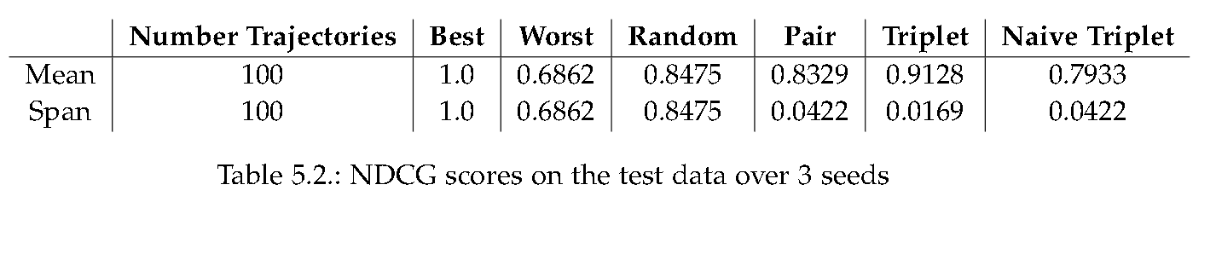
Ranking Quality

Slide 67
Correlation between Ground-truth Reward and Predictions
using Pearsons Correlation Coefficient and Spearmans Rank Correlation Coefficient
Intuition: if reward increases over time then predictions should also
compare monotonicity

Slide 68
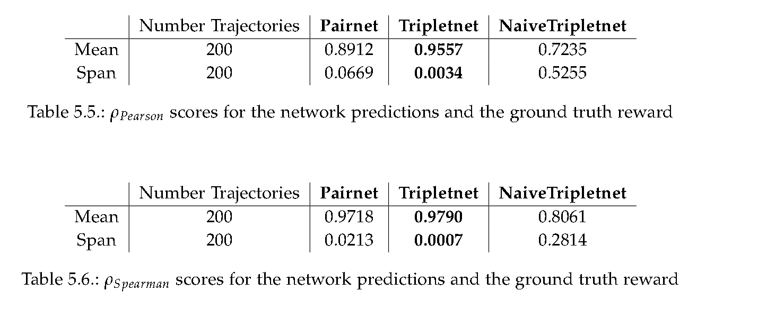
Correlation between Ground-truth Reward and Predictions

Slide 69
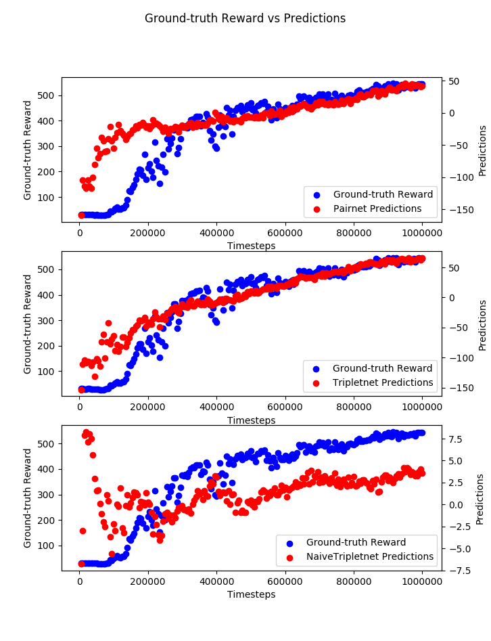
Correlation

Slide 70
Research Questions
Is it possible to teach a snake-like agent how to move forward efficiently using ranked, suboptimal trajectories?
all presented approaches move forward with moderate power consumption
How does the kind of used ranking mechanism impact the performance?
NaiveTriplet and Pair cover more distance than Triplet
The Triplet approach performs best on the ranking task and does even fine on unseen data
The Triplet approach achieves the highest correlation
Notes:
RQ as guide through today’s presentation

Slide 71
Steps
Motivation and Research Questions
Reinforcement Learning
Inverse Reinforcement Learning
Simulation & System Overview
Approach & Results
Critic
Outlook & Discussion

Slide 72
Critic
only tested on snake environment
many fixed hyperparameters
did not try out different ground-truth reward function
used one multiplies both features
contrary goals
only two loss approaches (not original ranking losses)
comparison to other IRL/ IL approaches missing (GAIL, BCO)

Slide 73
Steps
Motivation and Research Questions
Reinforcement Learning
Inverse Reinforcement Learning
Simulation & System Overview
Approach & Results
Critic
Outlook & Discussion

Slide 74
Outlook
Interesting research areas (LTR,DL,RL)
Apply advanced (differentiable) ranking losses
try out other (standard) environment
try out different hyperparameter configurations
especially network architecture

Slide 75
Questions?

Slide 76
Andreas Binder
Information System Student @ TUM, B.Sc.
inovex GmbH
Lindberghstraße 3
80939 Munich
abinder@inovex.de
01728746158

Slide 77
Backup Slides

Slide 78

Related Work
TODO vorziehen
https://arxiv.org/abs/1904.06387

Slide 79
PrefNet System
RL
Agent
Action
Gym
Snake Env
Tensorflow
State
PPO
Reward
Wrapper
MuJoCo
Physics
Engine
mujoco-py
PyTorch
Reward Function Approximator

Slide 80
PrefNet System
Reinforcement Learning
Tensorflow
Action
Gym
Snake Env
State
PPO
Reward
Wrapper
MuJoCo
Physics
Engine
mujoco-py
PyTorch
Reward Function Approximator

Slide 81

Try it out yoursef! vll raus
https://gym.openai.com/
Notes:
Encourage you to have a look yourself

Slide 82


Slide 83

Components
RL
Physics Simulation Engine: MuJoCo
Middleware: mujoco-py
Environment: gym
Deep RL
policy optimization: Tensorflow (baselines)
preference learning: PyTorch
Notes:
9 modules, 8 joints
wheels simulate

Slide 84
Related Work
TODO vorziehen
https://arxiv.org/abs/1904.06387

Slide 85
Veranschaulichen: Klassendiagramm, Codeschnippsel, weniger abstrakt
Q-Value Graphik ersetzen und Bedeutung erklären
F. 16/18 neu
F28; rew func abtasten
Andreas Binder
Munich, 08.09.2020

Slide 86

Role of Deep Learning
https://www.analyticsvidhya.com/blog/2019/04/introduction-deep-q-learning-python/
Notes:
DL + RL = Deep Reinforcement Learning
"quality" of an action taken in a given state

Slide 87
Reward Function

Slide 88

Infrastructure

